Slide 1
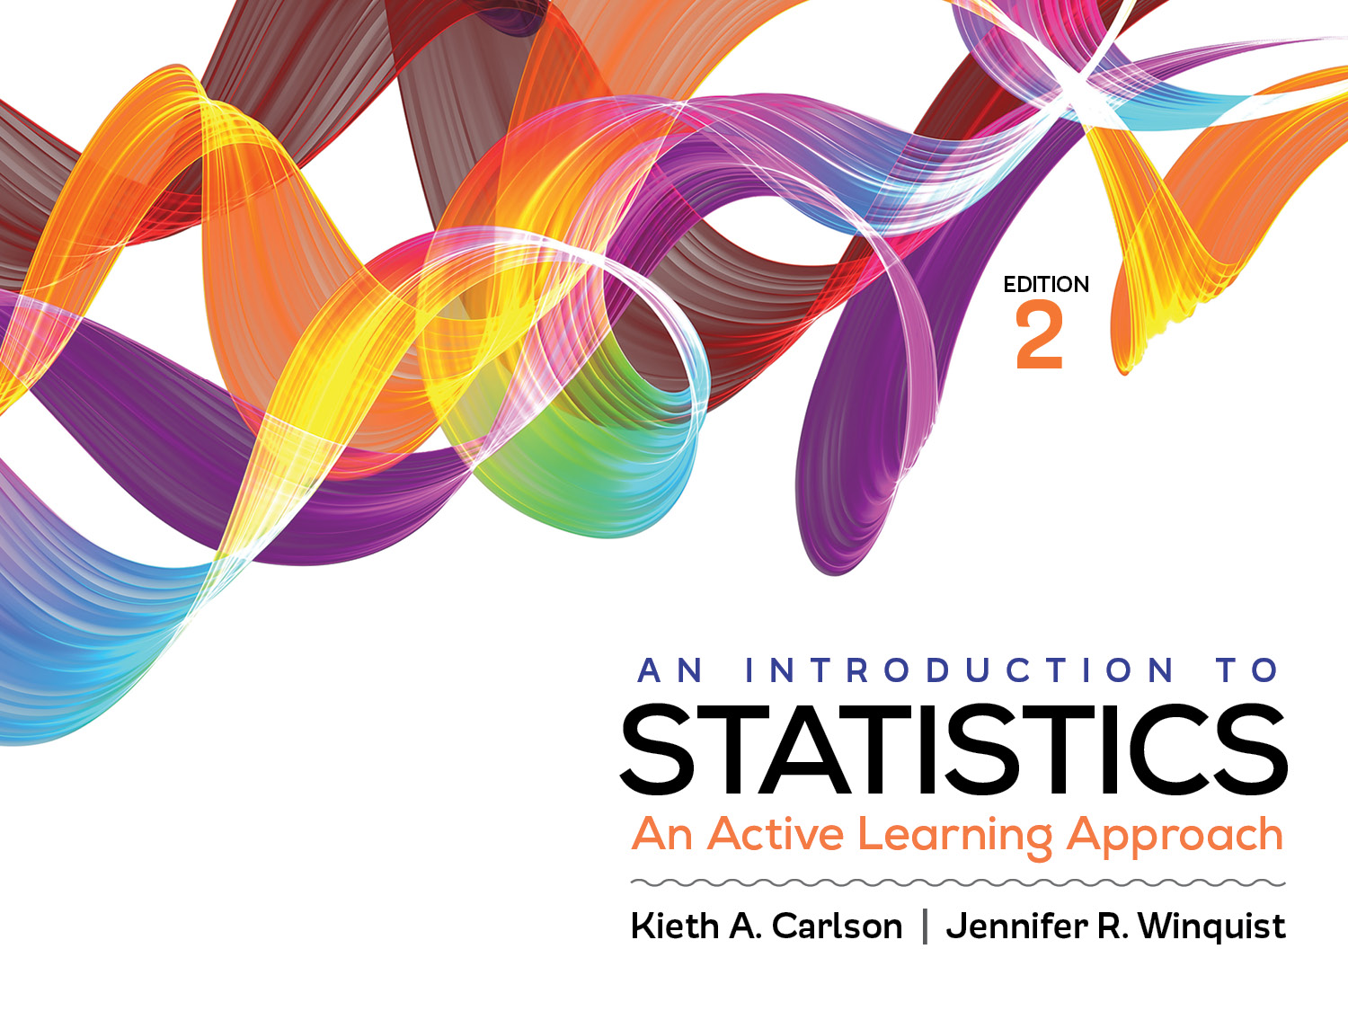
Introduction to Activity 11.5
ANOVAs, Effects Sizes, and Confidence Intervals

Slide 2
Activity 11.5 will require you to:
Use SPSS to conduct an independent ANOVA with confidence intervals
Interpret SPSS output
Compose an APA-style summary of the ANOVA results, include results from the significance test, effect sizes, and confidence intervals

Slide 3
Purposes of statistical procedures
Statistical procedure | Purpose
Significance testing | Decide if a treatment worked Determine if result is likely due to sampling error
Effect size | Describe how well a treatment worked
Confidence interval | Estimate a population parameter

